Slide 1
… and Questions
Q1. Cope, B., & Kalantzis, M. : “‘Fuck the System’ (‘the University of Illinois is a dehumanizing, anti-intellectual knowledge factory, a nursery for the infant adults of this great society’) (von Foerster 1969)”. In 2026 and beyond, will AI humanize – or instead worsen – the factory-like state of education?
Q2. Eastwood, B. (2026). “is this technology going to automate your kind of supporting tasks, (A) allow you to work more efficiently on things that you’re really good at, or is it going to (B) take your expert tasks and commoditize them so anyone can do them without you?”
Q3. Łodzikowski, K., Foltz, P. W., & Behrens, J. T. (2024). Personalized interaction and assessment – vs the “collaboration boundary”. How can we distinguish “‘what I have done’ and ‘what the computer has done’”, as both instruction and assessment become hyper-personalized?
Q4. Elim, E. H. S. Y. (2026). Where exactly do we want to add AI to education? At which phase(s)? At what levels of Bloom’s / Pappas’ taxonomies? Many want AI focused on lower-order tasks (applying, understanding, and remembering) but paradoxically it excels at higher-order tasks (creating, evaluating, and analyzing). But are we ready to offload these tasks?
Q5. Kosmyna, N., Hauptmann, E., Yuan, Y. T., Situ, J., Liao, X. H., Beresnitzky, A. V., Braunstein, I., & Maes, P. (2025). “Over four months, LLM users consistently underperformed at neural, linguistic, and behavioral levels.” How do we respond to this – do we need to place stronger guardrails on LLM use? However this study has had its critics. So also: how should we respond to studies of AI in classrooms?

Slide 2
Gen AI - Week 6
Applying a Pedagogical Lens

Slide 3
SECTION 01 / FRAMING
The Course So Far…
• Week 1: Introduction
• Week 2: Historical Lens
• Week 3: Technical Lens
• Week 4: Practical Lens
• Week 5: Critical Lens
• Week 6 / Today: Pedagogical Lens
• Week 7: Futurological Lens

Slide 4
SECTION 01 / FRAMING
Today
Discussion on Key Questions facing Education
Breakout rooms / Vibe Slide -> Moving towards Final Project
Interlude: Cong Wang on Charismatic AI
Break?
Breakout rooms: workshopping Final Project
Final (and Optional) Session: Liam (& Others) on the “Hidden Side” of AI deployment – tips & tricks from the field…

Slide 5
RECAP / WEEK 5
• Bias, Hallucination, Homogenization of knowledge
• Environmental effects, local & global: energy, water, real estate
• Alignment and its Discontents
• Data extractivism, digital neocolonialism, surveillance capitalism
• Geopolitical contestation
• Cult-like nature of AI visionaries, ideologies
• Concentration of wealth, power, control, culture
• Automation of labor, the economy, thinking
• “Greenwashing” AI ethics -> From Criticism to Critique
Recap…

Slide 6
CODA / PEDAGOGY
AI for Education
• Plagiarism; Cognitive offloading; “thin” or ephemeral learning
• Biased; No or insufficient safeguards
• Automated loops: students auto-write essays, teachers auto-grade them…
• Robot tutors, taking over teacher’s role
• Too much personalization, fragmentation of knowledge
• Education for what? Threats to future of work
• Futility of AI “work” – acceptance clicking, editing over writing
• School administration / management: assume AI leads to greater productivity
• Student apathy – why study hard? What’s the point of joining a rat race that has just a few real winners? (wider problem of declining middle class – Eubanks, Programmed Inequality (2019))

Slide 7
Readings
Cope, B., & Kalantzis, M. (2022). The Cybernetics of Learning. Educational Philosophy and Theory, 54(14), 2352-2388. https://doi.org/10.1080/00131857.2022.2033213
Eastwood, B. (2026). "What 2 MIT experts are thinking about AI and work". MIT Management. https://mitsloan.mit.edu/ideas-made-to-matter/what-2-mit-experts-are-thinking-about-ai-and-work?
Łodzikowski, K., Foltz, P. W., & Behrens, J. T. (2024). Generative AI and Its Educational Implications. In T. Kourkoulou, A. O. Tzirides, B. Cope, & M. Kalantzis (Eds.), Trust and Inclusion in AI-Mediated Education: Where Human Learning Meets Learning Machines. Springer. https://arxiv.org/abs/2401.08659
Elim, E. H. S. Y. (2026). Promoting Cognitive Skills in AI-supported Learning Environments: The Integration of Bloom’s Taxonomy. Education 3-13, 54(3), 612-622. https://www.tandfonline.com/doi/full/10.1080/03004279.2024.2332469
Kosmyna, N., Hauptmann, E., Yuan, Y. T., Situ, J., Liao, X. H., Beresnitzky, A. V., Braunstein, I., & Maes, P. (2025). Your brain on ChatGPT: Accumulation of cognitive debt when using an AI assistant for essay writing task. arXiv preprint arXiv:2506.08872, 4. https://www.media.mit.edu/publications/your-brain-on-chatgpt/

Slide 8
Readings
Cope, B., & Kalantzis, M. (2022). The Cybernetics of Learning. (‘the University of Illinois is a dehumanizing, anti-intellectual knowledge factory, a nursery for the infant adults of this great society’) (von Foerster, Citation1969). I
Eastwood, B. (2026). "What 2 MIT experts are thinking about AI and work". AI focussed on more repetitive tasks = higher wages. AI focussed on more analytical tasks: lower wages. “is this technology going to automate your kind of supporting tasks, allow you to work more efficiently on things that you’re really good at, or is it going to take your expert tasks and commoditize them so anyone can do them without you?”
Łodzikowski, K., Foltz, P. W., & Behrens, J. T. (2024). Generative AI and Its Educational Implications.
Elim, E. H. S. Y. (2026). Promoting Cognitive Skills in AI-supported Learning Environments: The Integration of Bloom’s Taxonomy. Do we see AI taking up the higher order (creative) skills? Or the lower order (remembering) skills? How do we encourage one over the other?
Kosmyna, N., Hauptmann, E., Yuan, Y. T., Situ, J., Liao, X. H., Beresnitzky, A. V., Braunstein, I., & Maes, P. (2025). Your brain on ChatGPT: Should we be using AI in the classroom? But also: How should we be reading studies of AI on education?

Slide 9
CLOSE
Vibe Sliding…
• Give me your notes, we’ll try to have Claude “vibe slide”…

Slide 10
ENGAGEMENT? MANIPULATION?
Charismatic AI

Slide 11
Intervening – Final Assessments
What needs to be done? What are the key problems?
From your words: Safety – Anthropomorphism / the “ELIZA Effect” – Manipulation – Hallucinations – Environmental Impacts – Cognitive Offloading / No “Productive Struggle” – Plagiarism – “Noetic Proleterianization” – Unrealistic Expecations (Oracle) – Transhumanist Fantasies – Over-alignment – Sycophancy …
But also: Surprising optimism in your responses. How do we manage ambiguity?
General discussion: what are people thinking of doing? Anyone stuck for ideas? Concerned about feasibility?
Back to group discussions: workshop ideas…
Review Assessment: https://cgscholar.com/posts/1208?communityId=141

Slide 12
CLOSE / HOUSEKEEPING
Brainstorming
• Discuss ideas for interventions
— What is the problem?
— Why is it a problem - who is affected, what are the consequences?
— How did the problem come to be? What are its causes?
— How can it be fixed - if at all? Are you optimistic about remedies & solutions?
— What might be the second order effects or unintended consequences?
• Present back

Slide 13
So you’ve built your first AI app / website / interactive HTML / game. Now what?
Missing part of puzzle: hosting / deployment / maintenance
Terminology:
“devops” = “development” (write the code) / “operations” (deploy it)
“Hosting”: a place to host web content – pages or apps
“Deployment”: move code from your machine to a public location / host
“Virtual machine” (VM): a machine within the machine, using software – manages many customers on a single computer, each with own memory, disk space etc
“Cloud computing”: a host who makes a virtual machine + other services available for a fee (Amazon Web Services, Microsoft Azure, Google Cloud)
TECH TALK / IF THERE’S TIME
The Hidden Side to Vibe Coding

Slide 14
Static:
HTML (Hypertext Markup Language) – document markup: paragraphs, bullet points, images, links etc
CSS (Cascading Style Sheets) – style: fonts, layout, colors, spacing, some animations etc
JavaScript – code: how document elements might interact (from validating fields to 3D animations)
Dynamic:
Page changes based on interaction: submit a form, get a custom response (Google.com – search, Gmail – email, ChatGPT.com – chat, etc)
Needs some kind of “back end”: hosting on a server (PHP, Python, also JavaScript). Necessary if you want to save information: custom surveys, assessments, feedback, multiuser info, personalization, persistence.
TECH TALK / IF THERE’S TIME
Static Pages vs
Dynamic Sites

Slide 15
From low to high complexity
Can you use ChatGPT / Claude / Google Gemini – “share” feature?
Copy / paste HTML / CSS / JavaScript to Canvas / LMS (not 100% guarantee)?
Save file(s) to Dropbox / Box etc? Ask AI to suggest naming protocols, integrate into a single HTML page containing CSS / Javascript.
Does the university / school have a hosting provider for websites?
Register yourself with static hosts like Dreamhost, BlueHost? Github also an option, but more complicated.
Use dynamic VM hosting providers like fly.io (cheap, DIY), or cloud providers (AWS etc)?
TECH TALK / IF THERE’S TIME
Where to Host?

Slide 16
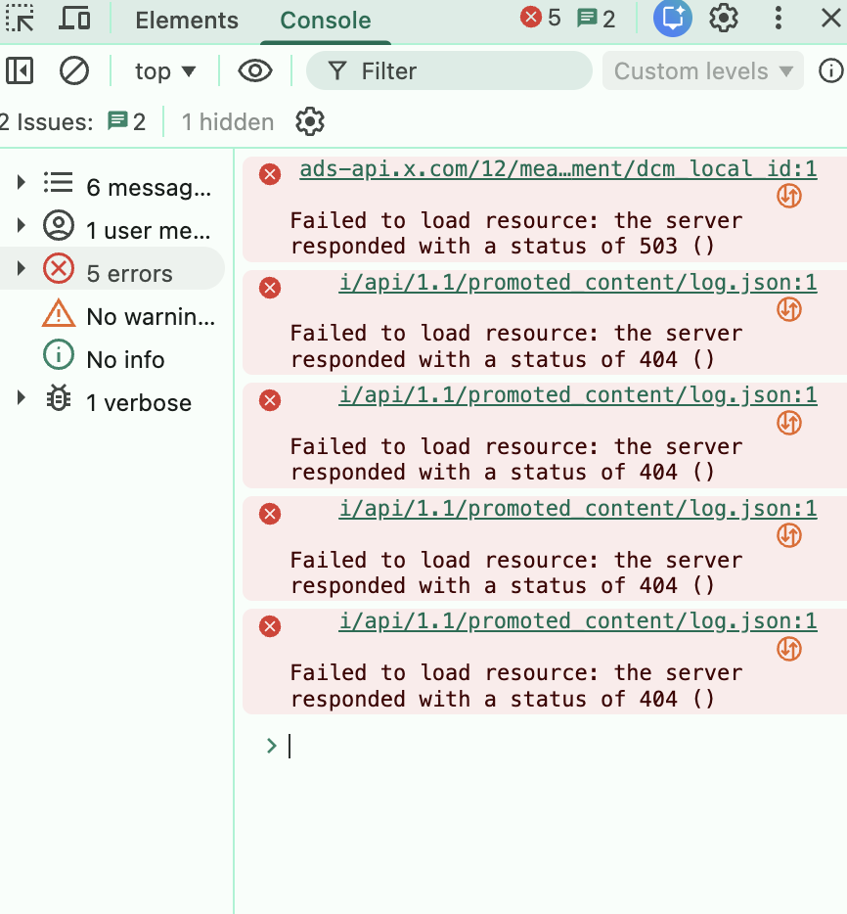
AI is rarely “one shot” – tell it what you want, get the perfect result first time.
So be prepared to iterate. Play the role of a polite but demanding client. Continue past the point of your own patience. AI use can be a test of endurance.
With technical work: learn keystrokes for (a) copy / paste; (b) screenshots; (c) Chrome / Safari Developer Tools (Option + Command + I on a Mac).
AI is excellent tech support. Copy errors, get feedback & instructions.
Both ChatGPT & Claude support “Computer Use”. Be very careful! When enabled, can do anything you can do (pay with credit cards, send emails etc). But can troubleshoot errors automatically, re-write code, test, repeatedly.
Have AI help with deployment, maintenance.
Learn git / Github for code version control? If things get serious with your AI use. But high learning curve.
TECH TALK / IF THERE’S TIME
Heuristics / Hard Lessons Learned

Slide 17
CLOSE
WarpStrike!
https://machinespirits.org/games/warpstrike/

